Slide 1
Assignment 5
Yufeng Zheng

Slide 2
Question 1
For this question, I first simulate the normal distribution and t-distribution based on the original data. Then, I calculate the VaR and CVaR value for empirical data, normal distribution data, and t-distribution data.

Slide 3


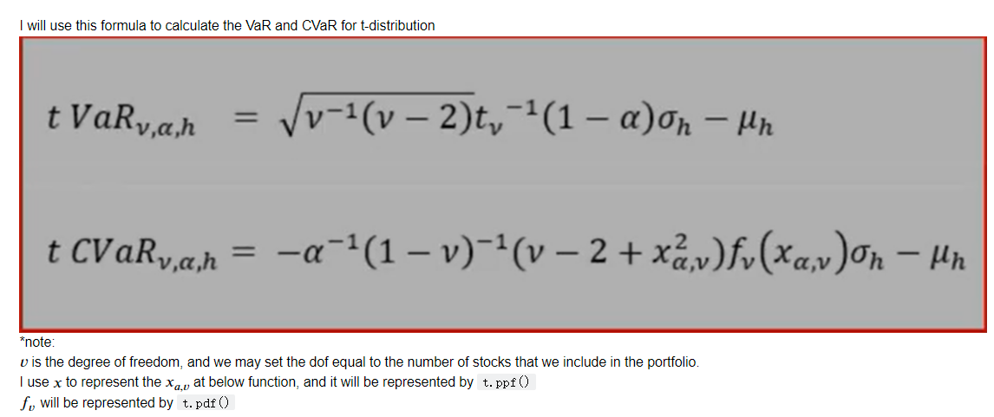
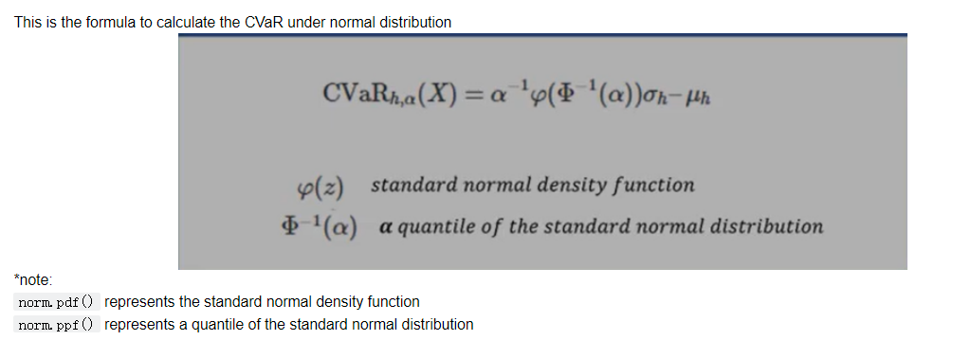
The math formula that I used

Slide 4
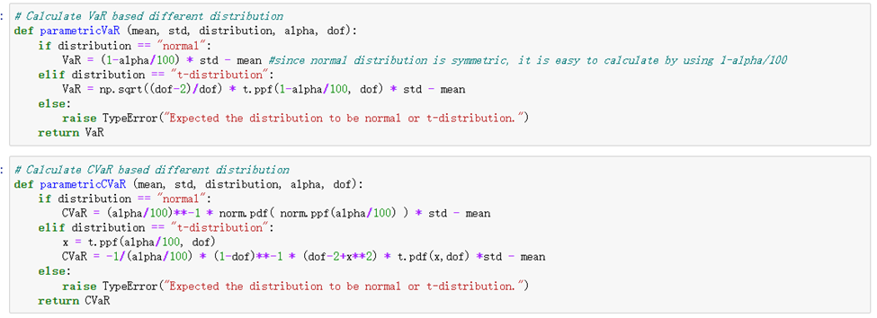
The functions that I wrote:

Slide 5
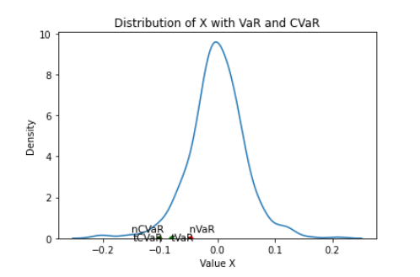
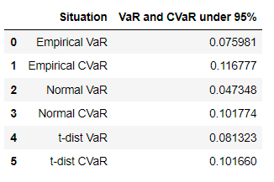
The result and plot that I get:

Slide 6
Question 2
All my functions already added in my notebook file.

Slide 7
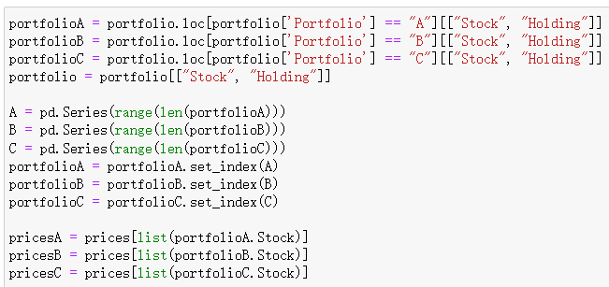
Question 3
First, I separated the portfolio into three portfolio.

Slide 8
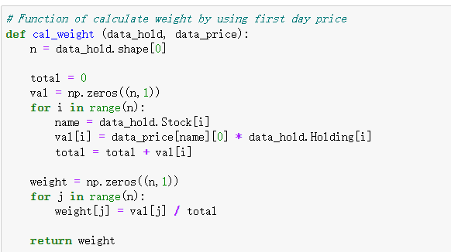
Then, I calculate the weights for each portfolio:

Slide 9
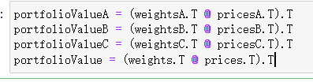
Then, I applied the weights onto portfolio price to calculate the portfolio total value for each days

Slide 10

Then, I calculate the rate of returns for each portfolio

Slide 11
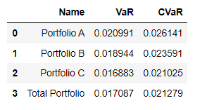
The result that I get:

